Slide 1
Predictive Analytics Technologies
(MSIS – 5633)
Crash Report Sampling System – 2019 Crash Data
Group Term Project
Date: 4/18/2022
Team Name: Distance Group 3
Moises C. Marin Martinez
Paul Dreyer
Aislynn Pasierb
Cassie Adams

Slide 2
Business Understanding & Purpose
228M
Licensed Drivers in U.S.
Tx, Ca, Fl
States with most fatal car accidents
Crash Data
Collected by the NHTSA
since the 1970s
NHTSA
National Highway Traffic
Safety Administration
Save lives, reduce costs
Through research, education, safety standards and enforcement activity.
Data from 2020
Notes:
In 2020, there where 228 million licensed drivers in the U.S.
Texas, California and Florida had the majority of those licensed drivers.
These three states also had the most fatal car accidents in 2020.
Some of the leading causes of fatal car accidents in the U.S. are distracted driving, reckless or aggressive driving, and driving under the influence.
these and other crash data have been collected by the National highway traffic safety administration or NHTSA since the early 1970s, using these data to support not only their own goals but also those of the highway safety community as well.
Understanding the causes behind fatal car accidents can help reduce their occurrence, and maximize the benefits obtained from applying budgets and resources towards reducing car crash fatalities.
NHTSA’s mission is to save lives, prevent injuries, and reduce the economic costs of roadway crashes through education, research, safety standards and enforcement activity.
In this report we are working with 2019 Crash Report Sampling System Data.

Slide 3
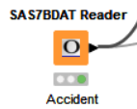
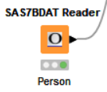
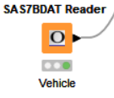
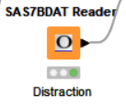
Data Understanding and Analysis
Data provided in four SAS files
Team analysis of data contained within files
Team members looked at individual tables to analyze the most important variables within their tables
Team members looked for missing data values, data values that looked incorrect, formatting issues
Also looked to make sure data columns were correctly classified, appropriately named, and that the supplied data had an overall format that was usable and intuitive

Slide 4
Data Understanding and Analysis: Table Interpretations
^{Accident Data}
^{People Data}
^{Distraction Data}
^{Vehicle Data}
^{50 variables}
^{56 variables}
^{11 variables}
^{90 variables}
^{54,409 rows}
^{135,410 rows}
^{96,751 rows}
^{96,717 rows}
The accident table included the lowest number of rows
People table included the highest number of rows
Distraction and vehicle contained almost an identical number of rows
Notes:
¹Decision Trees – Recursively divides a training set until each division consists entirely or primarily of examples from one class.
Attributes (variables), Class Labels (values for variables), Branches (outcome of a test), Nodes (final choice for a branch)
¹Random Forest - Develops a forest of many small trees. Uses bagging
Naïve Bayes - Uses naïve assumption that all features are independent and then uses probabilistic modeling to predict outcomes
Logistic Regression - Essentially draws a line through the datapoints to predict how x determines y
²Keboola. 2020. The Ultimate Guide to Decision Trees for Machine Learning. Retried from: https://www.keboola.com/blog/decision-trees-machine-learning
³Keboola. 2020. The Ultimate Guide to Random Forest Regression. Retried from: https://www.keboola.com/blog/random-forest-regression

Slide 5
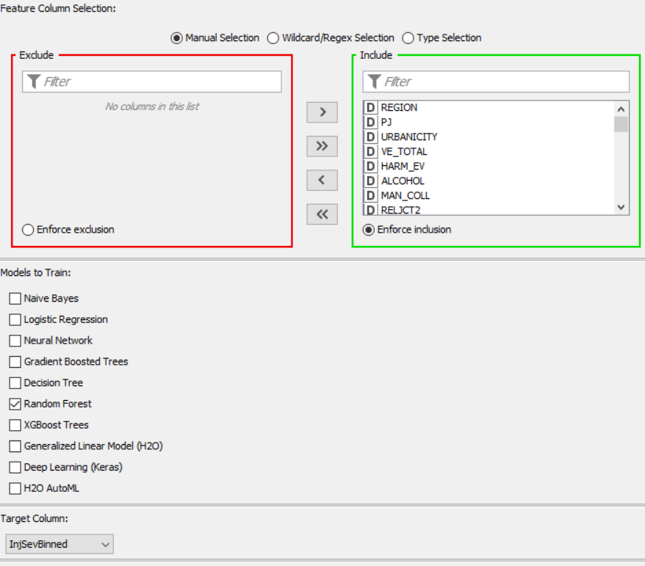
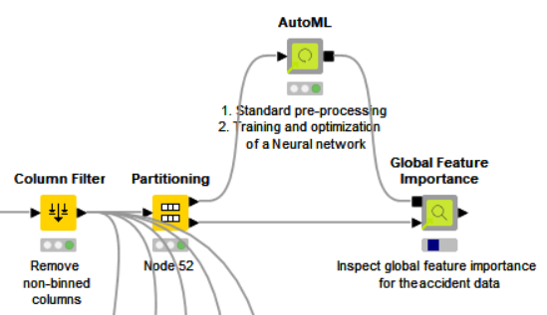
Data Understanding and Analysis
Team analysis of data contained within files
Determining the most important variables
By utilizing the AutoML H2O extension, we were actually given the option to train multiple models to find our most important variables. It was discovered that the Random Forest model provided the best outcome in terms of variable importance
Team members looked at individual tables to analyze the most important variables within their tables
Combined our most important variables and ran an H2O extension in KNIME in order to determine our most important 25 variables

Slide 6
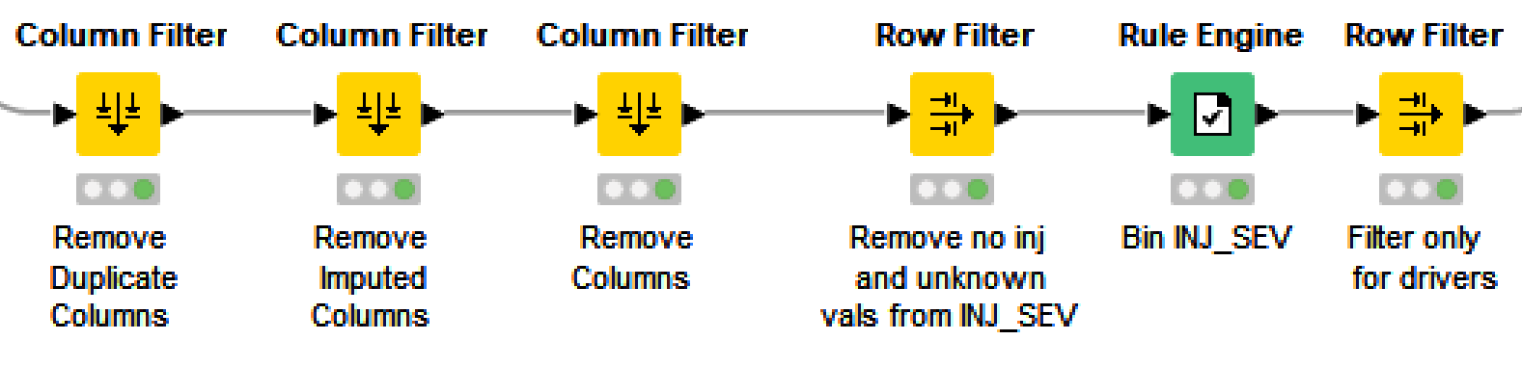
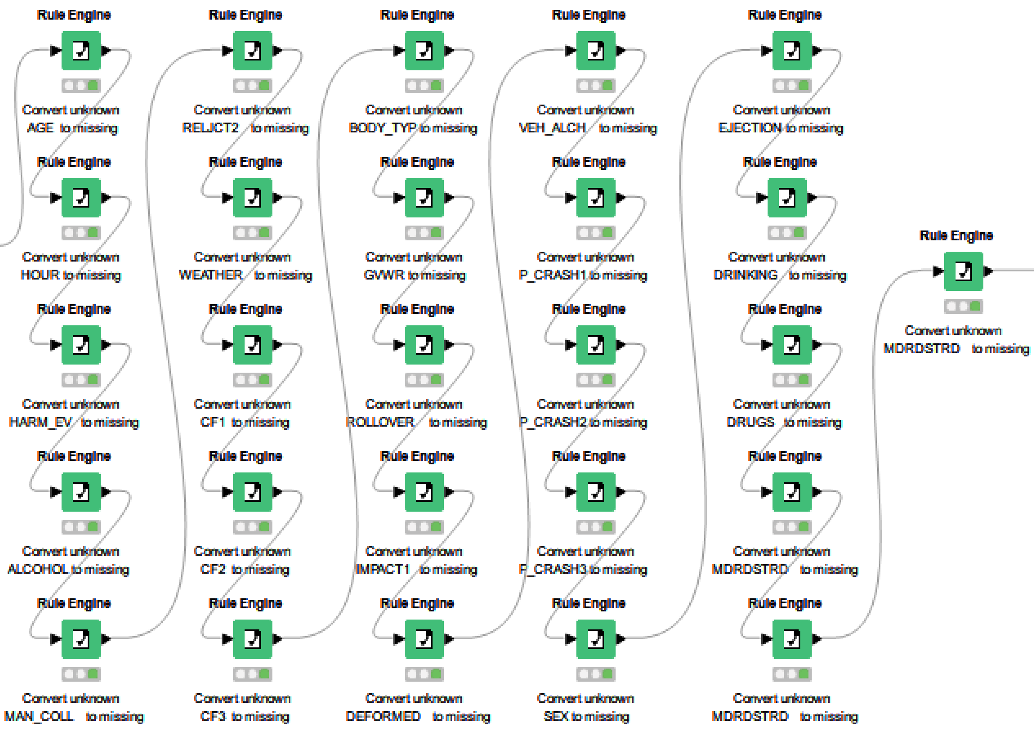
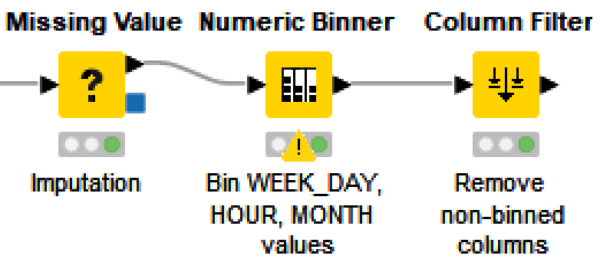
Data Preparation
Removal of columns
Duplicate columns
Imputed columns
Unneeded columns
Removal of records
INJ_SEV IN [1, 4]
SEAT_POS = 11
Binning Column Values
INJ_SEV: Low = [1,2]; High = [3,4]
WEEK_DAY: WEnd = [1,7]; WkDay = 2-6
HOUR: Early = 0-6; Morning = 6-12; Afternoon = 12-18; Night = 18-24
MONTH: Q1 = 1-3; Q2 = 4-6; Q3 = 7-9; Q4 = 10-12
Convert unknown column values to missing
Missing value treatment
Imputation using median

Slide 7
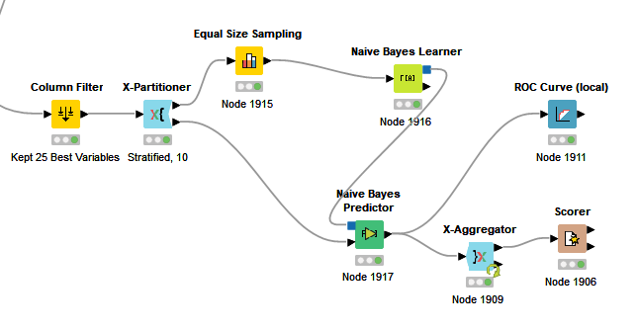
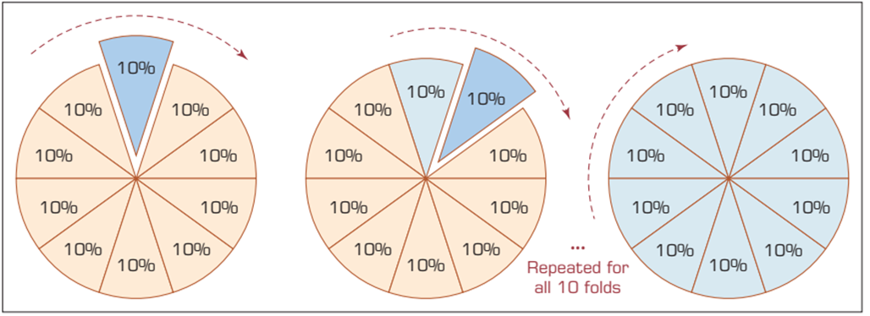
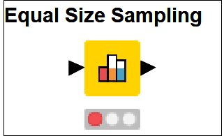
Model Building
Knime - https://www.knime.com/
Splitting Training & Testing Data¹
Balancing the Data
Notes:
¹K-fold cross-validation - complete data set is randomly split into k mutually exclusive subsets of approximately equal size. The classification model is trained and tested k times. Each time it is trained on all but one fold and then tested on the remaining single fold.
Equal Size Sampling: The node will remove random rows belonging to the majority classes. The rows returned by this node will contain all records from the minority class(es) and a random sample from each of the majority classes, whereby each sample contains as many objects as the minority class contains
¹ Ramesh, Sharda; Delen Dursun; Turban Efraim. Business Intelligence, Analytics, and Data Science (p. 218). Pearson Education. Kindle Edition.

Slide 8
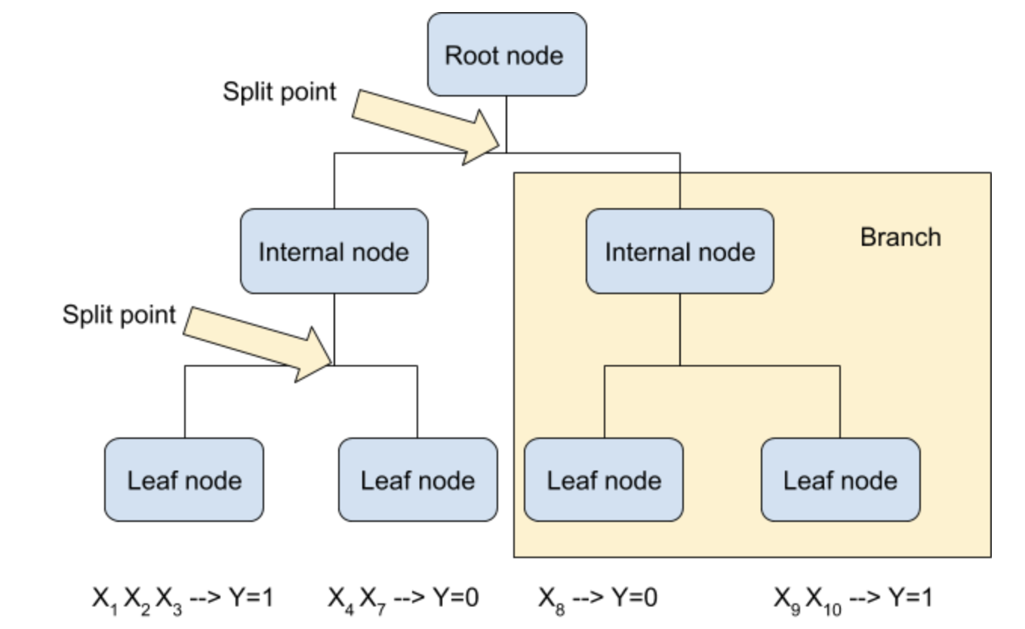
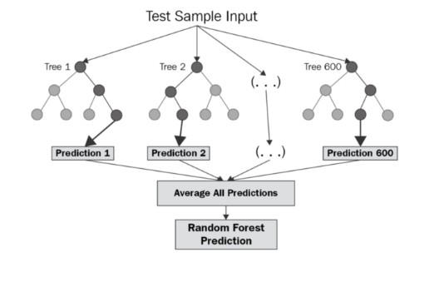
Model Building
Decision Tree²
Random Forest³
Notes:
²Decision Trees – Recursively divides a training set until each division consists entirely or primarily of examples from one class.
Attributes (variables), Class Labels (values for variables), Branches (outcome of a test), Nodes (final choice for a branch)
³Random Forest - Develops a forest of many small trees. Uses bagging
²Keboola. 2020. The Ultimate Guide to Decision Trees for Machine Learning. Retrieved from: https://www.keboola.com/blog/decision-trees-machine-learning
³Keboola. 2020. The Ultimate Guide to Random Forest Regression. Retrieved from: https://www.keboola.com/blog/random-forest-regression

Slide 9
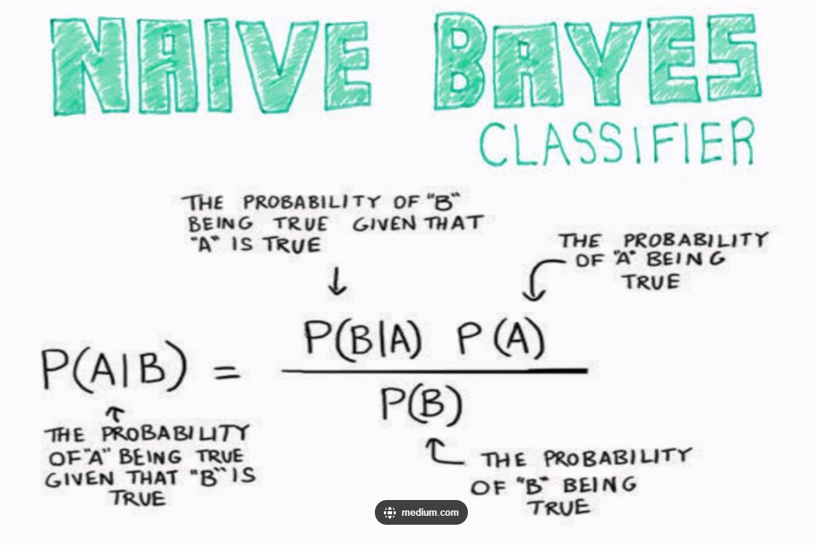
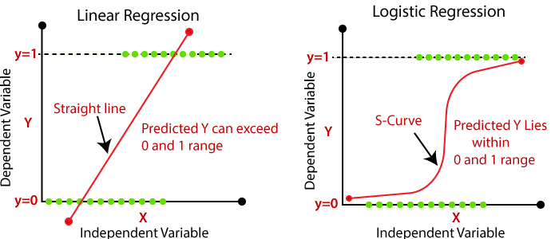
Model Building
Naïve Bayes⁴
Logistic Regression⁵
Notes:
Naïve Bayes - Uses naïve assumption that all features are independent and then uses probabilistic modeling to predict outcomes
Logistic Regression - Essentially draws a line through the datapoints to predict how x determines y
⁴Medium.com/Pranav. 2020. Naïve Bayes for Machine Learning. Retrieved from: https://medium.com/@pranav3nov/naive-bayes-for-machine-learning-b81ddf954031
⁵The Click Reader. 2022. Logistic Regression in Tensor Flow. Retrieved from: htttps://www.theclickreader.com/logistic-regression-in-tensorflow-2-0/

Slide 10
Testing & Evaluation
Results from AutoML H2O Extension
Team conducted an iterative analysis of the variables and models
Global Feature Importance Non-Binned MONTH, DAY_WEEK,HOUR |  |  | Global Feature Importance Binned MONTH, DAY_WEEK,HOUR
Top 25 Variables | Bottom 13 Variables |  | Top 25 Variables | Bottom 13 Variables
EJECTION | HELM_MIS |  | EJECTION | CF1
FIRE_EXP | RELJCT2 |  | FIRE_EXP | DEFORMED
PJ | SEX |  | VEH_ALCH | MDRDSTRD
ROLLOVER | REGION |  | ROLLOVER | P_CRASH1
MAN_COLL | URBANCITY |  | DRINKING | CF2
P_CRASH2 | WEATHER |  | HARM_EV | WEATHER
TRAV_SP | MDRDSTRD |  | VE_TOTAL | MONTH_binned
HARM_EV | GVWR |  | REST_MIS | SEX
VEH_ALCH | CF2 |  | ALCHOHOL | CF3
IMPACT1 | CF3 |  | DRUGS | URBANCITY
VE_TOTAL | J_KNIFE |  | P_CRASH2 | DAY_WEEK_binned
REST_MIS | HAZ_INV |  | MAN_COLL | HAZ-INV
DRINKING | SEAT_POS |  | PJ | SEAT_POS
HOUR |  |  | SPEEDREL
BODY_TYP |  |  | BODY_TYP
AGE |  |  | TRAV_SP
SPEEDREL |  |  | AGE
DEFORMED |  |  | IMPACT1
DAY_WEEK |  |  | HOUR_binned
P_CRASH1 |  |  | P_CRASH3
CF1 |  |  | REGION
MONTH |  |  | J_KNIFE
P_CRASH3 |  |  | GVWR
DRUGS |  |  | RELJCT2
ALCOHOL |  |  | HELM_MIS
The variables were modified and changed several times, running back through the AutoML H2O extension and the four machine learning models

Slide 11
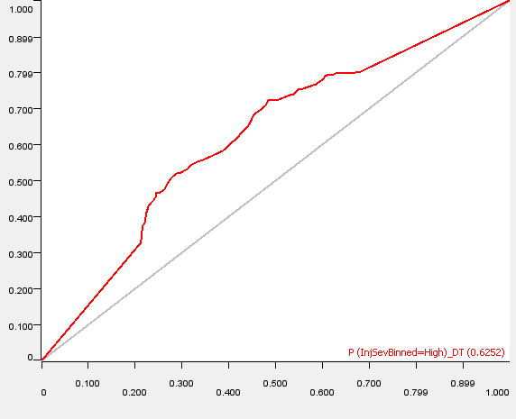
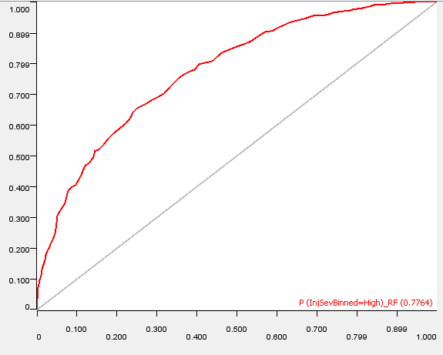
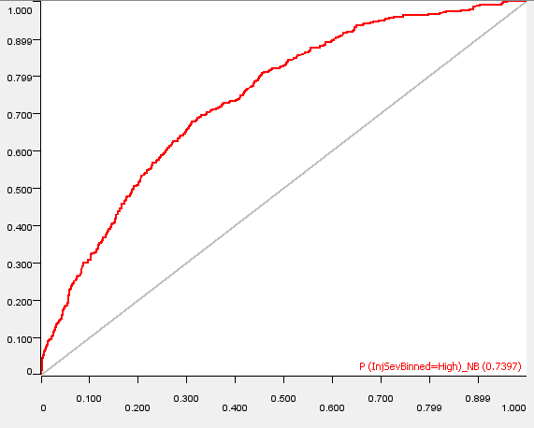
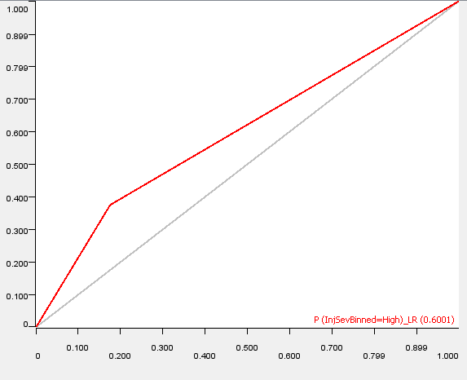
Testing & Evaluation
Models Binned MONTH, DAY_WEEK, HOUR
Model Type | Accuracy | Sensitivity | Specificity | ROC Value
Decision Tree | 60.5% | 0.61 | 0.60 | 0.61
Random Forest | 70.7% | 0.72 | 0.65 | 0.76
Naïve Bayes | 78.6% | 0.91 | 0.28 | 0.71
Logistic Regression | 68.8% | 0.75 | 0.414 | 0.53
Models Non-Binned MONTH, DAY_WEEK, HOUR
Model Type | Accuracy | Sensitivity | Specificity | ROC Value
Decision Tree | 61.0% | 0.61 | 0.60 | 0.63
Random Forest | 69.2% | 0.70 | 0.68 | 0.77
Naïve Bayes | 79.7% | 0.93 | 0.26 | 0.75
Logistic Regression | 61.1% | 0.64 | 0.487 | 0.60
Decision Tree
Random Forest
Naïve Bayes
Logistic Regression

Slide 12
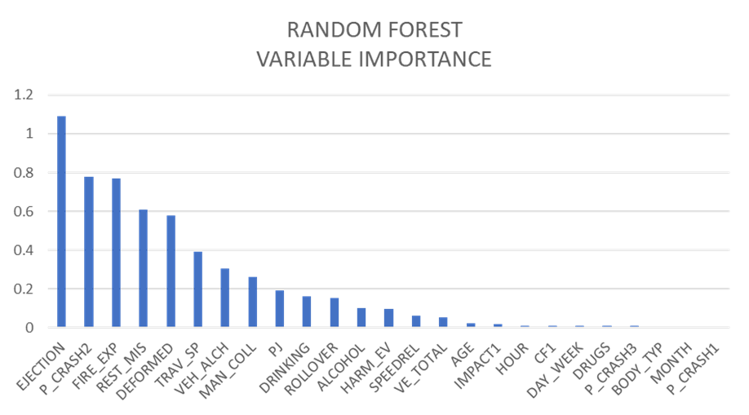
Testing & Evaluation

Slide 13
Deployment
NAÏVE BAYES MODEL
Best Model For Prediction
Key Variables to Consider
Final Thoughts
Improving Prediction Accuracy
Validity / Frequency to Retrain the Models

Slide 14
References
¹Author, Ramesh Sharda, Dursun Delen & Author, Efraim Turban (2018). Business Intelligence, Analytics, and Data Science: A Managerial Perspective (4th Edition).Publisher: Pearson, ©2018.
²Keboola. 2020. The Ultimate Guide to Decision Trees for Machine Learning. Retried from: https://www.keboola.com/blog/decision-trees-machine-learning
³Keboola. 2020. The Ultimate Guide to Random Forest Regression. Retried from: https://www.keboola.com/blog/random-forest-regression
⁴Medium.com/Pranav. 2020. Naïve Bayes for Machine Learning. Retrieved from: https://medium.com/@pranav3nov/naive-bayes-for-machine-learning-b81ddf954031
⁵The Click Reader. 2022. Logistic Regression in Tensor Flow. Retrieved from: htttps://www.theclickreader.com/logistic-regression-in-tensorflow-2-0/

